Slide 1


Unveiling YouTube Song Data: A Comprehensive Analysis
This presentation explores the power of YouTube song data analysis, revealing insights into viewer engagement, popularity trends, and content preferences.
By Nivedita Srivastava

Slide 2
Data Sources and Extraction
YouTube Data API
Web Scraping
Data Cleaning and Preprocessing
Leverage the YouTube Data API to gather structured data on songs, channels, and user interactions.
Extract additional information from YouTube pages, such as video descriptions, tags, and comments, using web scraping techniques.
Clean and format the extracted data, handle missing values, and prepare it for analysis within Power BI.

Slide 3

Data Transformation and Modeling
1
Data Shaping
Transform the raw data into a suitable format for analysis, creating relationships between tables and optimizing data structures.
2
Data Modeling
Design a data model that reflects the relationships between different data entities, enabling efficient analysis and report creation.
3
Data Aggregation
Aggregate data at different levels, such as daily, weekly, or monthly, to gain insights into trends and patterns.

Slide 4

Key Attributes and Metrics
Video ID
Unique identifier for each video.
Channel Title
Name of the YouTube channel that uploaded the song.
Title
Title of the YouTube song video.
Description
Textual description accompanying the video.
Tags
Keywords associated with the video.
Published Date
Date when the video was uploaded.
View Count
Number of times the video has been viewed.
Like Count
Number of likes received by the video.
Favorite Count
Number of times the video has been added to user playlists.
Comment Count
Number of comments left on the video.
Video Duration
Length of the video in seconds.
Video Definition
Quality of the video (e.g., 480p, 720p, 1080p).
Caption Details
Information about captions, such as language and availability.

Slide 5
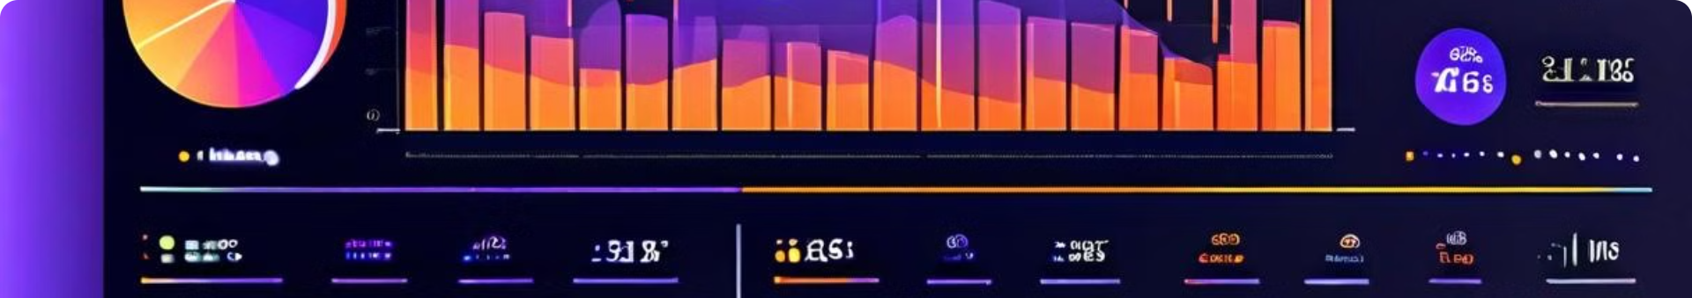
Visualizing Video Performance
1
View Count Trend
2
Like-to-View Ratio
A line chart visualizing the growth of view count over time, revealing popularity trends and potential spikes in engagement.
A bar chart comparing the ratio of likes to views for different songs, indicating user preference and engagement levels.
3
Comment Distribution
4
Video Duration Analysis
A histogram showing the distribution of comments across different time intervals, highlighting peak engagement periods.
A scatter plot showing the relationship between video duration and view count, identifying optimal video lengths for maximum engagement.

Slide 6
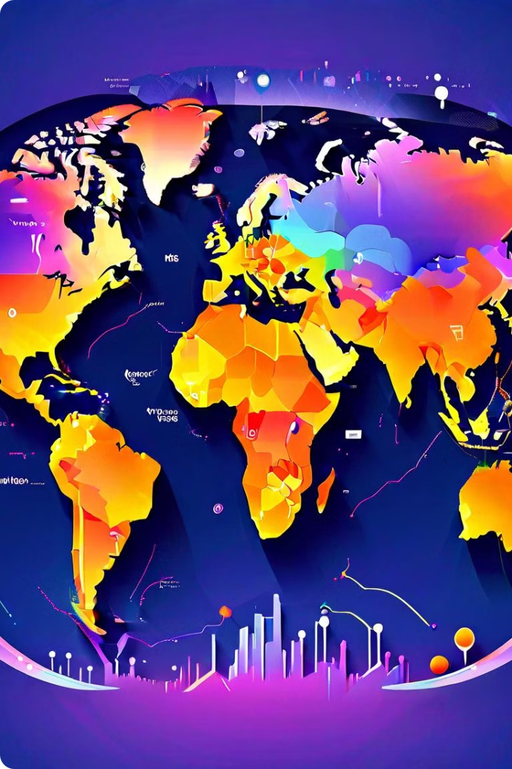




Analyzing Popularity Trends
Trend Analysis
Identify trends in view count, like count, and other metrics, analyzing seasonal variations and spikes in popularity.
Top Performing Songs
Create a ranked list of songs with the highest view count, likes, and engagement, revealing the most popular content.
Genre Analysis
Analyze the popularity of different music genres, identifying audience preferences and trending styles.

Slide 7
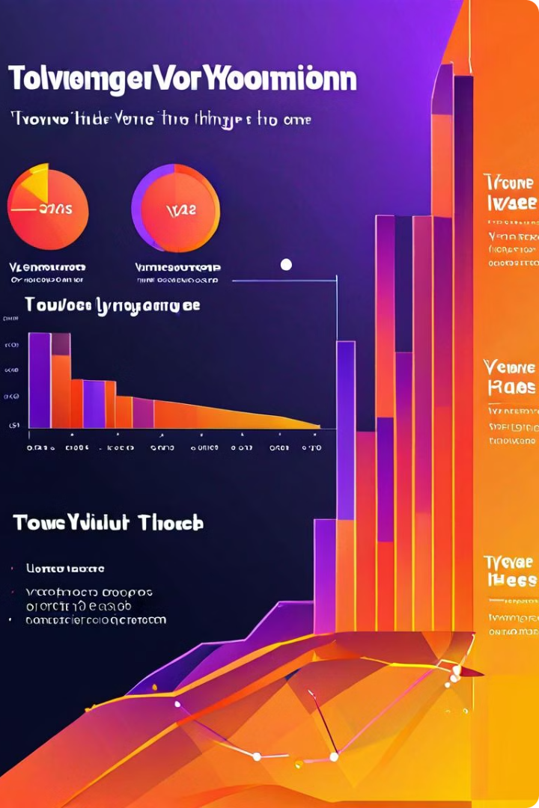
Understanding User Engagement
Average Watch Time
Calculate the average duration viewers spend watching a song, indicating viewer interest and attention span.
Comment Sentiment Analysis
Analyze the sentiment of comments using natural language processing, understanding user reactions and opinions.
Social Sharing Analysis
Track the number of shares on social media platforms, revealing the viral potential of songs and user engagement.
Audience Demographics
Analyze viewer demographics, such as age, location, and interests, to understand the target audience.

Slide 8





Identifying Content Preferences
Genre Popularity
Analyze the frequency of different music genres in the dataset, identifying the most popular styles among viewers.
Playlist Analysis
Examine the content of playlists to understand how users group songs together, uncovering related themes and preferences.
Search Term Analysis
Analyze the search terms used by viewers to find songs, revealing trending topics and audience interests.
Comment Analysis
Identify recurring themes and topics discussed in comments, understanding viewer reactions and preferences.

Slide 9
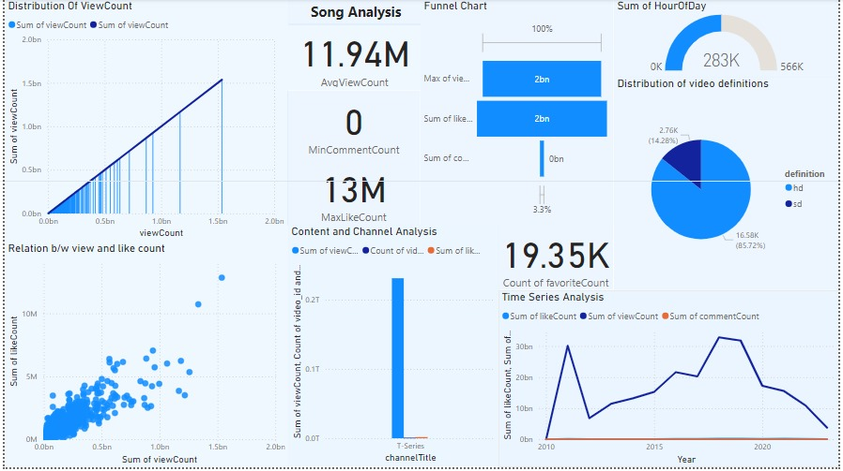

Slide 10

Uncovering Patterns and Insights
Peak Engagement Periods
1
Identify specific times of the day, week, or year when engagement is highest, revealing optimal times for content release.
2
Viewer Behavior Patterns
Analyze user interaction patterns, such as the time spent watching, commenting, and sharing videos, understanding viewer habits.
Content Optimization Strategies
3
Identify effective strategies for optimizing video titles, descriptions, and tags to enhance discoverability and engagement.

Slide 11
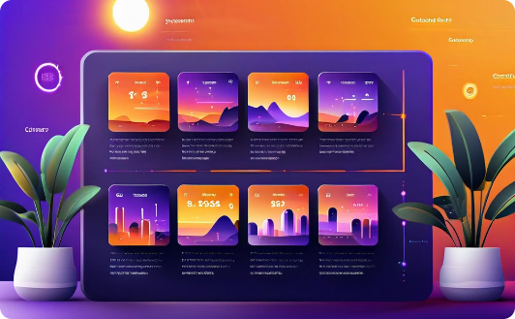
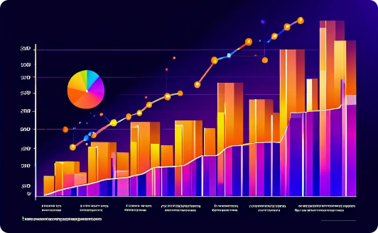

Recommendations for Content Creators
Content Planning and Strategy
Audience Engagement and Growth
Video Optimization and Promotion
Develop a strategic content plan based on audience preferences and trending topics, ensuring consistent and engaging content.
Engage with viewers through comments, Q&A sessions, and social media interactions to build a strong and loyal community.
Optimize video titles, descriptions, and tags to improve searchability, and utilize social media and other platforms for promotion.

